Slide 1
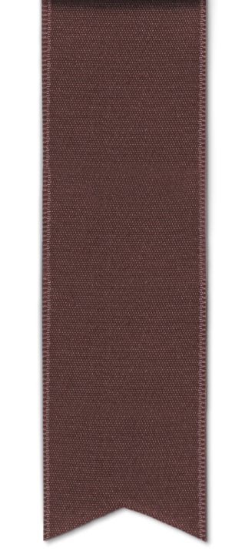

UR2526ECE753
UROP Project ID
Fish-Inspired Binocular Vision System for Wide-Field Underwater Perception in Bionic Robotic Fish
Project Mentor
Dr. Monika R
Dept Electronics and Communication Engineering
Student details ( with Reg No, Department)
GAJULA VISHNU VARDHAN (RA2411004010230)
SRIVIGNESH.B(RA2311004010587)
Dept Electronics and Communication Engineering
Notes:
NOTE:
To change the image on this slide, select the picture and delete it. Then click the Pictures icon in the placeholder to insert your own image.
1

Slide 2
Problem Statement & Motivation
A. Problem Statement
Conventional underwater monitoring methods rely on human divers and fixed cameras, which are costly, risky, and unsuitable for continuous data collection.
Most low-cost underwater robots are limited to basic locomotion and simple video capture, lacking intelligent perception and environmental sensing capabilities.
There is a need for an autonomous underwater system that combines efficient locomotion, real-time sensing, and intelligent perception.
This project focuses on designing a biomimetic robotic fish AUV capable of autonomous swimming, real-time temperature and pressure sensing, and intelligent underwater object detection using a YOLO-based deep learning model to identify marine organisms.
B. Motivation
Marine ecosystems are increasingly impacted by pollution, climate change, and human activities.
Continuous underwater monitoring is essential for understanding and protecting these ecosystems.
Traditional monitoring methods provide only short-duration observations and involve high operational risks.
A small autonomous robotic fish can operate silently for extended periods, minimizing disturbance to marine life.
By integrating environmental sensors and real-time object detection, the proposed AUV acts as an intelligent underwater observer.
The system enables reliable and automated data collection for marine research, conservation, and underwater surveillance applications.
2
UROP Review Meeting -AY 2025-26 ODD

Slide 3
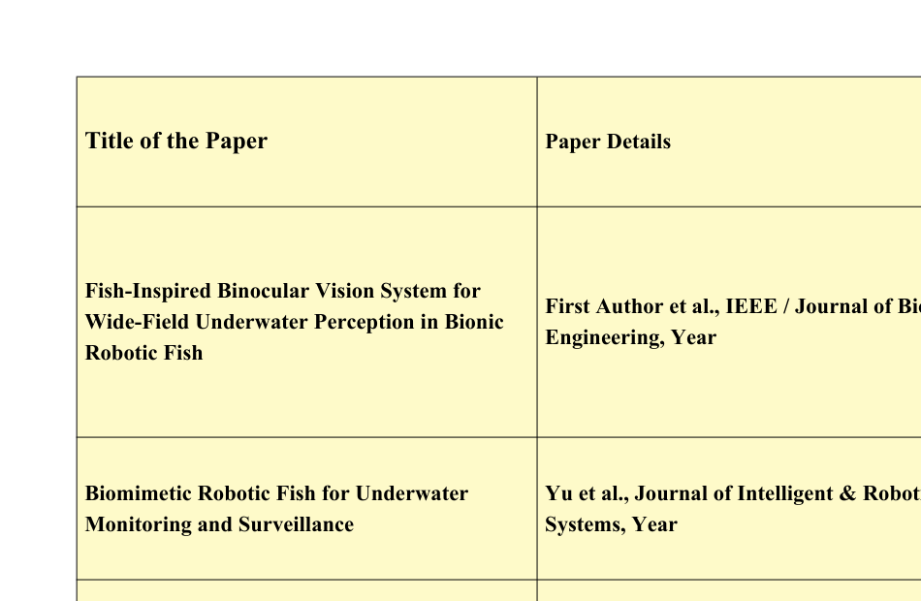
Literature Review Summary
UROP Review Meeting -AY 2025-26 ODD
3

Slide 4
Methodology Adopted/ to be followed
The project adopts a simulation-based methodology for the development of an underwater surveillance robotic fish.
A fish-inspired robotic model is designed and implemented in the Gazebo simulation environment to enable safe, cost-effective, and repeatable testing without real-world risks.
Biomimetic swimming behavior is incorporated to replicate natural fish locomotion and ensure smooth and stable underwater navigation.
A binocular vision system is simulated using two virtual cameras mounted symmetrically on the robotic fish body.
This stereo camera configuration provides a wider field of view and improved environmental perception.
Visual data captured by the cameras is processed using Python, and YOLOv8 implemented with PyTorch is used for real-time underwater object detection and classification.
Stereo vision techniques are applied for basic depth estimation, enabling distance measurement to nearby objects.
Simulated sensor data, including position and orientation information, supports navigation and obstacle awareness.
The complete system is evaluated under various underwater simulation scenarios in Gazebo to analyze detection accuracy, perception capability, and overall system performance.
UROP Review Meeting -AY 2025-26 ODD
4

Slide 5
Work done so far
Fish-Inspired Motion and Control Framework
Developed biologically inspired swimming motion models in both 2D and 3D to replicate natural fish locomotion.
Modeled smooth depth variations and sensor noise to closely reflect real-world underwater operating conditions.
Implemented an Extended Kalman Filter (EKF) for robust state estimation under noisy sensor measurements.
Designed PID-based depth control and waypoint navigation algorithms to ensure stable and accurate motion control.
Incorporated ocean current effects into the motion model to achieve drift-compensated and realistic underwater movement.
Perception and Vision Foundations
Studied the complete YOLO object detection pipeline with a focus on its application to underwater visual scenes.
Implemented YOLO-based object detection models and analyzed bounding box predictions for various underwater objects.
Evaluated confidence scores and identified detection limitations under challenging conditions such as low visibility, motion blur, and lighting variations.
Software and Development Setup
Established a Python-based development environment using Visual Studio Code on a Windows platform.
Installed, configured, and validated essential libraries including OpenCV and NumPy for image processing and numerical computation.
Reviewed the end-to-end detection code workflow and resolved dependency and compatibility issues to ensure stable execution.
UROP Review Meeting -AY 2025-26 ODD
5

Slide 6
Results & Discussion ( if any)
The binocular vision system provides superior situational awareness compared to a single-camera configuration by offering a wider field of view and improved perception of the surrounding environment.
Objects approaching from lateral directions are detected more reliably, which is crucial for effective underwater surveillance and navigation.
The biomimetic fish-like swimming mechanism produces smooth and stable motion, closely resembling natural fish locomotion.
This natural swimming behavior enables efficient maneuvering and maintains stability during movement in the underwater environment.
Stable locomotion reduces visual disturbances, leading to improved image quality and more consistent object detection performance.
The YOLOv8 deep learning model successfully detects and labels underwater objects in real time within the simulated environment.
The integration of AI-based object detection, biomimetic locomotion, and binocular vision enhances obstacle avoidance capability and overall navigation efficiency.
The combined system demonstrates improved reliability and robustness during autonomous operation.
Overall, the results confirm that integrating natural fish motion with intelligent stereo vision significantly improves the performance of autonomous underwater surveillance systems.
UROP Review Meeting -AY 2025-26 ODD
6

Slide 7
Work to be done
Future Scope
Design and fabricate a physical biomimetic robotic fish prototype based on the simulated model.
Select and integrate waterproof low-light cameras suitable for underwater binocular vision.
Implement proper camera housing and optical window design to reduce refraction and distortion underwater.
Integrate real temperature and pressure sensors with the onboard control system for environmental monitoring.
Deploy image enhancement techniques such as underwater color correction, dehazing, and contrast enhancement to improve visual quality.
Fine-tune the YOLO-based object detection model using real underwater image datasets captured from the prototype.
Implement real-time stereo depth estimation using calibrated binocular camera data.
Port the perception and control algorithms to an embedded computing platform such as Raspberry Pi or NVIDIA Jetson.
Perform pool or controlled water-tank experiments to validate swimming stability, perception accuracy, and detection performance.
Extend the system to include acoustic or sonar sensors for perception in low-visibility underwater conditions.
UROP Review Meeting -AY 2025-26 ODD
7

Slide 8
Contribution of each student team member
Studied object detection fundamentals and compared traditional computer vision with deep learning–based methods.
Understood the YOLO algorithm for real-time object detection.
Set up the Python environment in VS Code and configured required libraries (OpenCV, NumPy).
Organized YOLO files (config, class labels, pre-trained weights) and analyzed the detection pipeline.
Successfully ran YOLO-based object detection on sample images and validated outputs.
Resolved environment and dependency issues during implementation.
Developed a level-wise AUV simulation framework from basic 2D motion to advanced 3D navigation.
Implemented 2D and 3D AUV motion models with heading, speed, and depth variation.
Modeled sensor noise and generated noisy measurements to reflect real-world conditions.
Designed and implemented Extended Kalman Filter (EKF) for AUV state estimation.
Performed range-only EKF localization using fixed underwater beacons.
Studied the impact of sensor noise and time-varying ocean currents on AUV trajectories.
Implemented waypoint navigation and PID-based depth control for the AUV.
Visualized results using 2D and 3D plots for performance analysis.
UROP Review Meeting -AY 2025-26 ODD
8

Slide 9
UROP Progress( Highlight your status of completion)
Phase1
10%
Phase 2 30%
Phase 3 50%-70%
Phase 4 -80%
Literature Review
Modelling
Analysis
Paper Submitted to Journal
Literature gap
Simulation
Paper drafting
Under Review
Problem identification
Experiment
Objectives formulation
UROP Review Meeting -AY 2025-26 ODD
9

Slide 10
References
References
[1] J. Yu, L. Wang, and M. Tan, “A survey on CPG-inspired control models and system implementation,” IEEE Transactions on Neural Networks, vol. 25, no. 3, pp. 441–456, 2014.
[2] J. Yu, Z. Wu, and M. Tan, “Biomimetic robotic fish: Design, modeling, and experiments,” Journal of Intelligent & Robotic Systems, vol. 62, no. 3–4, pp. 363–381, 2011.
[3] S. Negahdaripour and H. Madjidi, “Stereovision imaging on submersible platforms for 3-D mapping of benthic habitats,” IEEE Journal of Oceanic Engineering, vol. 28, no. 4, pp. 625–650, 2003.
[4] A. Redmon et al., “You Only Look Once: Unified, real-time object detection,” Proceedings of the IEEE Conference on Computer Vision and Pattern Recognition (CVPR), pp. 779–788, 2016.
[5] G. Jocher et al., “YOLOv8: Ultralytics object detection framework,” Ultralytics, 2023.
[Online]. Available: https://ultralytics.com
[6] N. Koenig and A. Howard, “Design and use paradigms for Gazebo, an open-source multi-robot simulator,” IEEE/RSJ International Conference on Intelligent Robots and Systems (IROS), pp. 2149–2154, 2004.
UROP Review Meeting -AY 2025-26 ODD
10

